Slide 1
Sixth sense technology
Presented by:-
18RH1A0550
Durga Kalyani
4th cse-a

Slide 2
ABSTRACT
Sixth Sense Technology integrates digital information into the physical world and its objects, making the entire world your computer.
It can turn any surface into a touch-screen for computing, controlled by simple hand gestures.
It also supports multi user and multi touch provisions. Sixth Sense device is a mini-projector coupled with a camera and a cell phone-which acts as the computer and your connection to the Cloud, all the information stored on the web.
The current prototype costs around $350. The Sixth Sense prototype is used to implement several applications that have shown the usefulness, viability and flexibility of the system.

Slide 3
introduction
Sixth Sense is a wearable gestural interface that augments the physical world around us with digital information and lets us use natural hand gestures to interact with that information.
Steve Mann is considered as the father of sixth sense Technology who made wearable computer in 1990. He implemented the Sixth Sense Technology as the neck worn projector with a camera system.
Then his work was carried forward by Pranav Mistry.

Slide 4
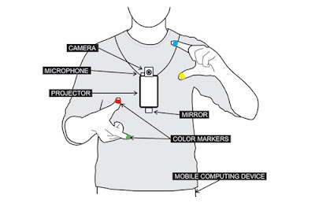
The Devices which are used in sixth sense technology are:
Camera.
Colored Marker.
Mobile Component.
Mirror
Projector.

Slide 5
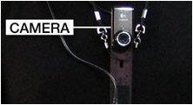
camera
Captures an object in view and tracks the user’s hand gestures
It sends the data to smart phone.
It acts as digital eye, connecting you to the world of digital information.

Slide 6
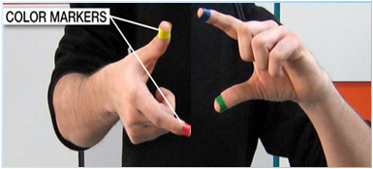
Color markers
It is at the tip of the user’s fingers.
Marking the user’s fingers with red, yellow, green, and blue tape help the webcam recognize gestures.
The movements and arrangements of these markets are interpreted into gestures that act as interaction instructions for the projected application interfaces.

Slide 7
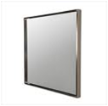
Mirror
The usage of the mirror is significant as the projector dangles pointing downwards from the neck.

Slide 8

Smart Phone
A web-enabled smartphone in the user’s pocket processes the video data.
Other software searches the Web and interprets the hand gestures.

Slide 9
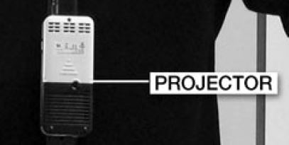
projector
The projector projects visual information enabling surfaces and physical objects to be used as interfaces
The project itself contains a battery inside, with 3 hours of battery life.
A tiny LED projector displays data sent from the smartphone on any surface in view-object, wall, or person.

Slide 10
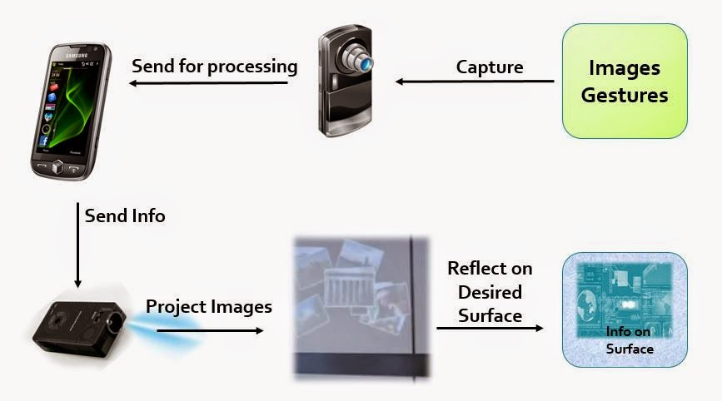
How does it work

Slide 11
Applications
Make A call.
Call up a map.
Check the time.
Create multimedia reading experiences.
Get flight updates.
Take pictures.
Drawing applications.

Slide 12
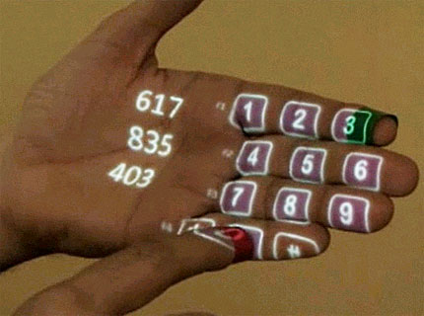
Make a call
You can use the sixth sense to project a keypad onto your hand, then use that virtual keypad to make a call.

Slide 13
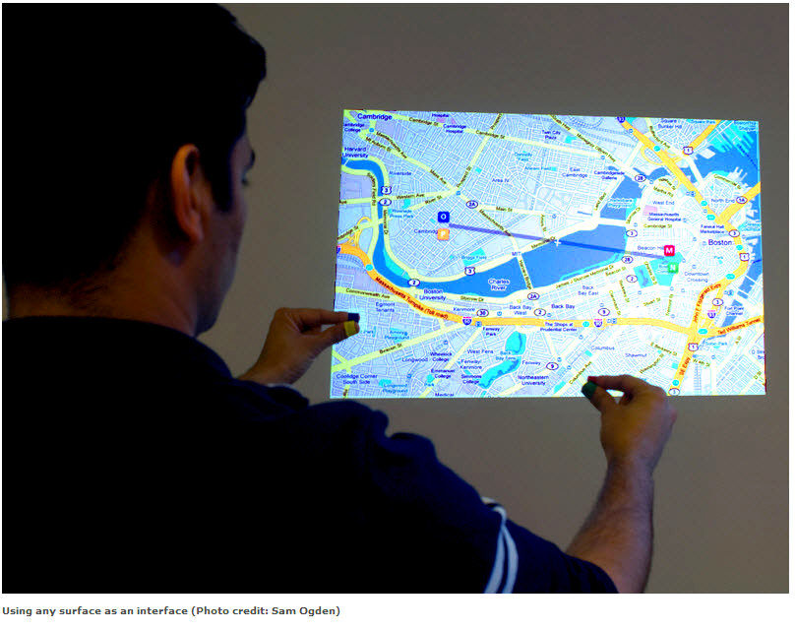
Call up a map
With the map application we can call up the map of our choice and then use thumbs and index fingers to navigate the map.

Slide 14
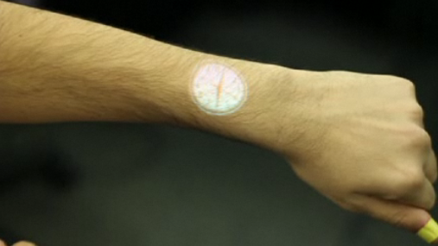
Check the time
Draw a circle on your wrist to get virtual watch that gives you the correct time.

Slide 15
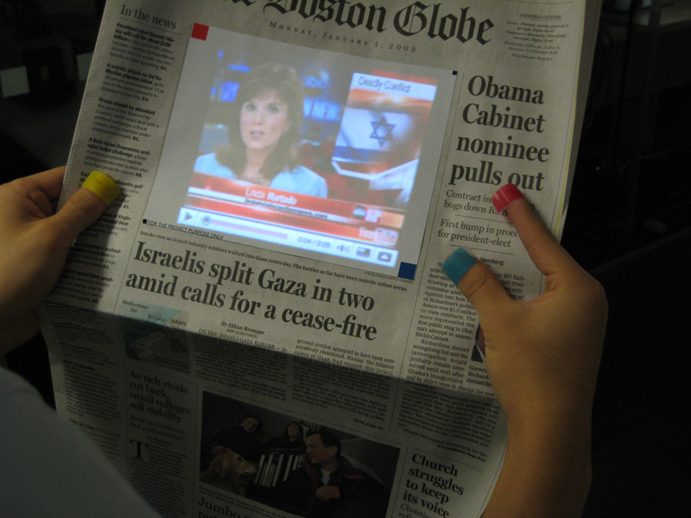
Create multimedia reading experiences
Sixth sense can be programmed to project related videos onto newspaper articles you are reading.

Slide 16
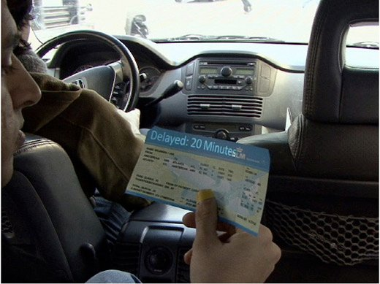
Get flight updates
The system will recognize your boarding pass and let you know whether your flight is on time and if the gate has changed.

Slide 17
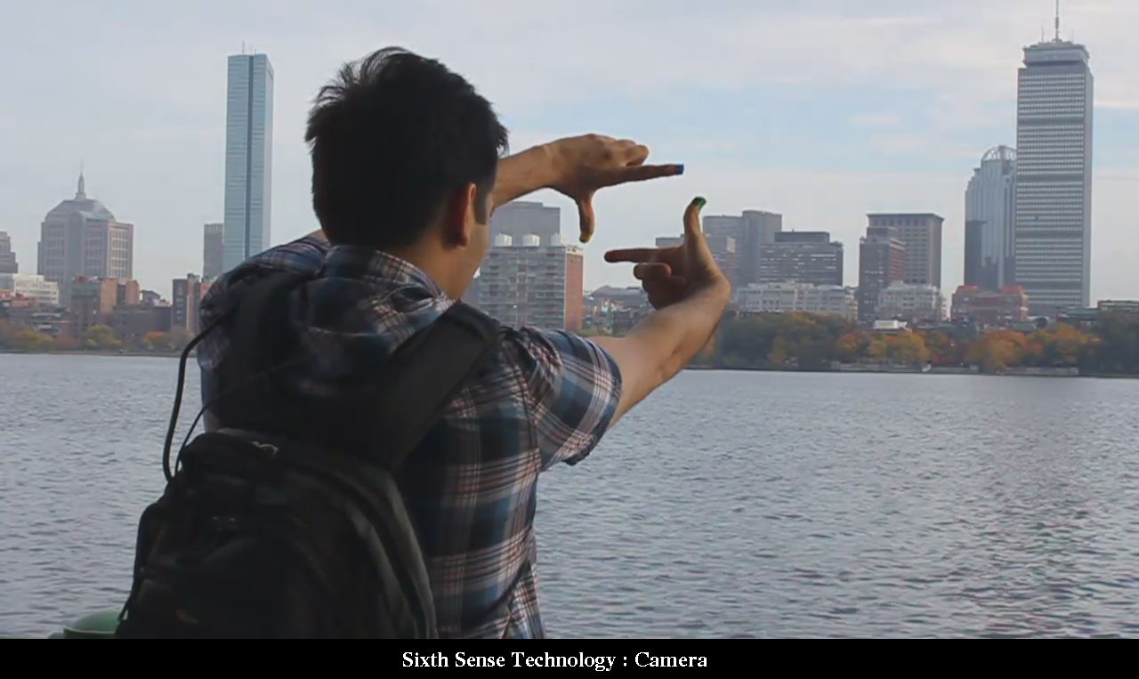
Take pictures
If you fashion your index fingers and thumbs into a square, the system will snap a photo.
After taking the desired number of photos, we can project them onto a surface, and use gestures to sort through the photos, and organize and resize them.

Slide 18
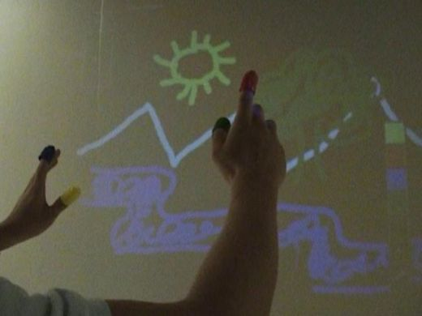
Drawing application
The drawing application lets the user draw on any surface by tracking the fingertip movements of the user’s index finger.

Slide 19
Advantages
Portable
Support Multi touch and Multi user interaction.
Cost Effective.
Data access directly from the machines in real time.
Mind map the idea anywhere.
Open Source Software.

Slide 20
disadvantage
Hardware limitations of the devices, that we currently carry around with us.
For example many phones will not allow the external camera feed to be manipulated in the real time.

Slide 21
FUTURE SCOPE:-
There are many scopes of further modifications to this technology:
To get rid of color markers
To embedded camera and projector inside mobile and computing devices
To have 3D gesture tracking
To make Sixth sense work as a fifth sense for disabled people

Slide 22
conclusion
Sixth Sense recognizes the objects around us, displaying information automatically and letting us to access it in any way we need.
The Sixth Sense prototype implements several applications that demonstrate the usefulness, viability and flexibility of the system.
The potential of becoming the ultimate “transparent” user interface for accessing information about everything around us.
Allowing us to interact with this information via natural hand gestures.

Slide 23
References
[1] www.pranavmistry.com/projects/sixthsense/
[2] www.engineersgarage.com/articles/sixth-sense-technology
[3] IEEE Computer, Vol. 30, No. 2, February 1997, Wearable Computing: A First Step Toward Personal Imaging, pp25-32
[4] https://en.wikipedia.org/wiki/SixthSense

Slide 24


